Slide 1
Seminar on SIMDJSON
Presented by
Mohit Gurbani
Information Technology VIII Semester

Slide 2
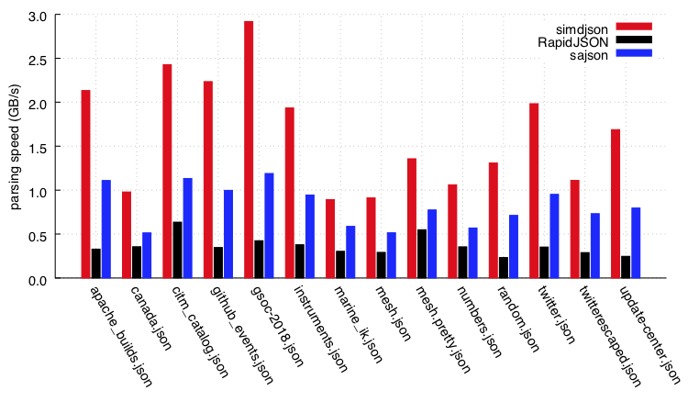
About SIMDJSON
Some performance results
Parsing gigabytes of JSON per second
A C++ library to see how fast we can parse JSON with complete validation.
JSON documents are everywhere on the Internet. Servers spend a lot of time parsing these documents. We want to accelerate the parsing of JSON per se using commonly available SIMD instructions as much as possible while doing full validation (including character encoding).
Some performance results
We can use a quarter or fewer instructions than a state-of-the-art parser like RapidJSON, and half as many as sajson. To our knowledge, simdjson is the first fully-validating JSON parser to run at gigabytes per second on commodity processors.
Notes:
Let us see some performance results when tested in real life. On an early note I can tell you that this takes half parsing time compared to sajson & lesser instructions than RapidJson.
We need such a technology which can transfer metadata at higher speeds. We already know Shanon, Huffman(Bottom Up), Lempel-Ziv. For more smooth motion with D2F bridge we use Middle-Out compression than just a single compression.

Slide 3
On a Skylake processor, the parsing speeds (in GB/s) of various processors on the twitter.json file are as follows.
Parser | GB/s
Simdjson | 2.2
RapidJSON encoding-validation | 0.51
RapidJSON encoding-validation, insitu | 0.71
Sajson (insitu, dynamic) | 0.70
Sajson (insitu, static) | 0.97
Dropbox | 0.14
Fastjson | 0.26
Gason | 0.85
Ultrajson | 0.42
Jsmn | 0.28
Cjson | 0.34
Notes:
Skylake is codename used by Intel for microarchitecture released in 2015. It is the original core i7 chip. Skylake is mostly compared with the KABYLake made on 14nm released in 2016.

Slide 4
Requirements
We support platforms like Linux or macOS, as well as Windows through Visual Studio 2017 or later.
- A processor with AVX2 (i.e., Intel processors starting with the Haswell microarchitecture released 2013, and processors from AMD starting with the Ryzen)
- A recent C++ compiler (e.g., GNU GCC or LLVM CLANG or Visual Studio 2017), we assume C++17. GNU GCC 7 or better or LLVM's clang 6 or better.
- Some benchmark scripts assume bash and other common utilities, but they are optional.

Slide 5
Code Examples
It is also possible to use a simpler API if you do not mind having the overhead of memory allocation with each new JSON document:
#include "simdjson/jsonparser.h"
const char * filename = ... //
std::string_view p = get_corpus(filename);
ParsedJson pj;
pj.allocateCapacity(p.size());
bool is_ok = json_parse(p, pj);
free((void*)p.data());
#include "simdjson/jsonparser.h"
const char * filename = ... //
std::string_view p = get_corpus(filename);
ParsedJson pj = build_parsed_json(p); // do the parsing
if( ! pj.isValid() ) {
// something went wrong
}

Slide 6
Usage CMake on Linux or macOS
brew install cmake
brew install gcc@8
mkdir build
cd build
export CXX=g++-8 CC=gcc-8
cmake ..
make
make test
Notes:
Usage on multiple platforms

Slide 7
Usage CMake on Windows (using Visual Studio)
Grab the simdjson code from GitHub, e.g., by cloning it using [GitHub Desktop].
Install [CMake]. When you install it, make sure to ask that “cMake” be made available from the command line. Please choose a recent version of cmake.
Create a subdirectory within simdjson, such as “VisualStudio”.
Using a shell, go to this newly created directory.
Type “cmake -DCMAKE_GENERATOR_PLATFORM=x64 ..” in the shell while in the “VisualStudio” repository.
This last command created a Visual Studio solution file in the newly created directory (e.g. “simdjson.sln”). Open this file in Visual Studio. You should now be able to build the project and run the tests. For example, in the “Solution Explorer” window, right-click “ALL_BUILD” and select “Build”. To test the code, still in the “Solution Explorer” window, select “RUN_TESTS” and select “Build”.
Notes:
We are assuming that you have a common Windows PC with at least Visual Studio 2017, and an x64 processor with AVX2 support (2013 Haswell or later).

Slide 8
Scope
We provide a fast parser. It fully validates the input according to the various specifications. The parser builds a useful immutable (read-only) DOM (document-object model) which can be later accessed.
To simplify the engineering, we make some assumptions.
We support UTF-8 (and thus ASCII), nothing else (no Latin, no UTF-16). We do not believe that this is a genuine limitation in the sense that we do not think that there is any serious application that needs to process JSON data without an ASCII or UTF-8 encoding.
We store strings as NULL terminated C strings. Thus we implicitly assume that you do not include a NULL character within your string, which is allowed technically speaking if you escape it (\u0000).
We assume AVX2 support which is available in all recent mainstream x86 processors produced by AMD and Intel. No support for non-x86 processors is included though it can be done. We plan to support ARM processors (help is invited).
In cases of failure, we just report a failure without any indication as to the nature of the problem. (This can be easily improved without affecting performance.)
As allowed by the specification, we allow repeated keys within an object (other parsers like sajson do the same).
Performance is optimized for JSON documents spanning at least a few kilobytes up to many megabytes: the performance issues with having to parse many tiny JSON documents or one truly enormous JSON document are different.
We do not aim to provide a general-purpose JSON library. A library like RapidJSON offers much more than just parsing, it helps you generate JSON and offers various other convenient functions. We merely parse the document.

Slide 9
Features
The input string is unmodified. (Parsers like sajson and RapidJSON use the input string as a buffer.)
We parse integers and floating-point numbers as separate types which allows us to support large 64-bit integers in [-9223372036854775808,9223372036854775808), like a Java `long` or a C/C++ `long long`. Among the parsers that differentiate between integers and floating-point numbers, not all support 64-bit integers. (For example, sajson rejects JSON files with integers larger than or equal to 2147483648. RapidJSON will parse a file containing an overly long integer like 18446744073709551616 as a floating-point number.) When we cannot represent exactly an integer as a signed 64-bit value, we reject the JSON document.
We do full UTF-8 validation as part of the parsing. (Parsers like fastjson, gason and dropbox json11 do not do UTF-8 validation.)
We fully validate the numbers. (Parsers like gason and ultranjson will accept `[0e+]` as valid JSON.)
We validate string content for unescaped characters. (Parsers like fastjson and ultrajson accept unescaped line breaks and tabs in strings.)

Slide 10
Architecture
The parser works in two stages:
Stage 1. (Find marks) Identifies quickly structure elements, strings, and so forth. We validate UTF-8 encoding at that stage.
Stage 2. (Structure building) Involves constructing a "tree" of sort (materialized as a tape) to navigate through the data. Strings and numbers are parsed at this stage.

Slide 11
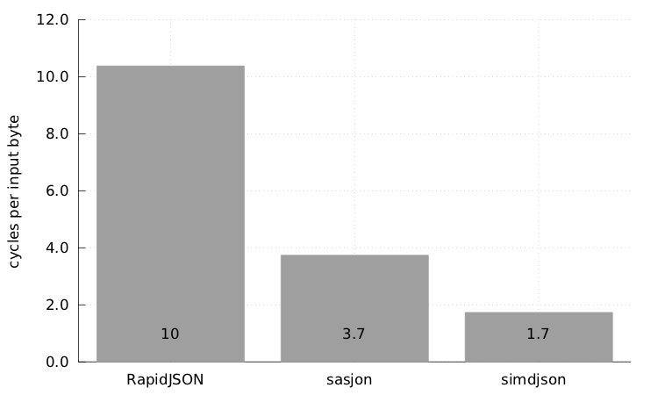
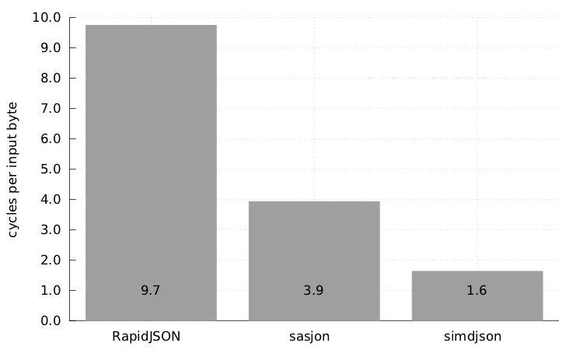
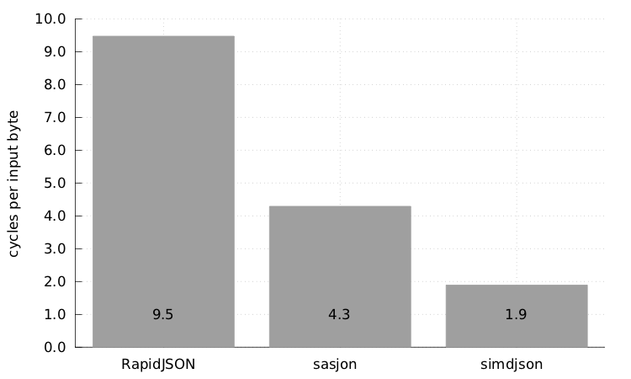
In depth comparisions
If you want to see how a wide range of parsers validate a given JSON file:
> make allparserscheckfile
> ./allparserscheckfile myfile.json
For performance comparisons:
> make parsingcompetition
> ./parsingcompetition myfile.json
For broader comparisons:
> make allparsingcompetition
> ./allparsingcompetition myfile.json
Twitter Event Json Parsing
Github Event Json Parsing
Apache Build Json Parsing

Slide 12
Other programming languages
pysimdjson: Python bindings for the simdjson project.
simdJsonSharp: C# version for .NET Core
simdjson_nodejs: Node.js bindings for the simdjson project.
The structural characters are:
begin-array = [ left square bracket
begin-object = { left curly bracket
end-array = ] right square bracket
end-object = } right curly bracket
name-separator = : colon
value-separator = , comma

Slide 13

Any Queries…?

Slide 14

Thank You

